Slide 1
Office 365 Content Search and eDiscovery Case Management WorkshopPLUS

Slide 2















Jenkins NS
Modern Workplace Solution Architect | Consultant
Chennai, India
MVP | MCT | International Speaker | Author | Trainer
Microsoft Teams, Power Platform and SPFx Specialist
M365 Bangalore Organizer
aMS Ambassador
SharePoint-er Since 2005!
@jenkinsns
https://www.linkedin.com/in/jenkinsns/
http://www.jenkinsblogs.com
https://www.youtube.com/user/jenkinsnss

Slide 3
Module agenda
Permissions for Content Search and eDiscovery
Content Search
Core eDiscovery
Advanced eDiscovery

Slide 4
Module 1: Permissions for Content Search and eDiscovery
This module covers which permissions are needed to perform various activities in the Security and Compliance Center related to Content Search, Core eDiscovery and Advanced eDiscovery.

Slide 5
Module introduction
After this module, you should be able to:
Assign eDiscovery permissions
RBAC roles related to eDiscovery
Case Management
Adding role groups as members of eDiscovery cases

Slide 6
Assign eDiscovery permissions
eDiscovery (Premium) is not a part of every tenant. To experience its goodness, you need either an E5 subscription with the E5 Compliance add-on or E3 with the E5 eDiscovery and Audit add-on.
Another important requirement to keep in mind is permissions. Back in the day, eDiscovery mechanism based on the permissions from the Exchange admin center. Currently, the Microsoft Purview compliance portal has its own, independent Permissions settings page. To manage eDiscovery cases, a user needs to be assigned an eDiscovery role group – eDiscovery Manager.
eDiscovery role
eDiscovery Manager
eDiscovery Administrator

Slide 7
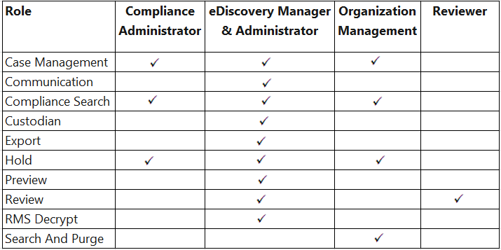
RBAC roles related to eDiscovery

Slide 8
Case Management
This role lets users create, edit, delete, and control access to eDiscovery (Standard) and eDiscovery (Premium) cases in the compliance portal. As previously explained, a user must be assigned the Case Management role before you can use the Add-eDiscoveryCaseAdmin cmdlet to make them an eDiscovery Administrator.

Slide 9
Adding role groups as members of eDiscovery cases
You can add role groups as members of eDiscovery (Standard) and eDiscovery (Premium) cases so that members of the role groups can access and perform tasks in the assigned cases. The roles assigned to the role group define what members of the role group can do. Then adding a role group as a member of the case lets members access and perform those tasks in a specific case.
Add or remove members from an eDiscovery (Premium) case
Get a list of eDiscovery (Standard) cases a role group is assigned to
Get-ComplianceCase -RoleGroup "Name of role group"
Get a list of eDiscovery (Premium) cases a role group is assigned to
Get-ComplianceCase -RoleGroup "Name of role group" -CaseType AdvancedEdiscovery

Slide 10
Lab - Permissions for Content Search and eDiscovery

Slide 11
Lab exercises
Exercise 1: Assign eDiscovery permissions

Slide 12
Module 2: Content Search
This module covers how to perform a Content Search using keyword query language, differences in types of returned data, how to preview the content and how to export the reports/results.

Slide 13
Module introduction
After this module, you should be able to:
Use content search in Microsoft 365
Configure search permission filtering
Search for third-party data
Describe when to use scripts for advanced searches
Conduct a data subject request search for GDPR

Slide 14
Content Search explained
In contrast to eDiscovery searches, the Content Search feature in the Security and Compliance Center has no limits on the number of mailboxes and sites that you can search
Content Search contains enhanced performance capabilities that are useful when running very large eDiscovery searches
After you run a Content Search, the number of content sources and an estimated number of search results are displayed for:
Exchange Online mailboxes and public folders
SharePoint Online sites and OneDrive for Business accounts
Skype for Business conversations
Microsoft Teams messages and sites
Microsoft 365 Groups messages and sites
To-Dos and MyAnalytics

Slide 15
Design your Content Search
You should consider the following questions when designing a Content Search:
Who should create and run the content search?
What type of content search do you want to create (for example, New search, Guided search, Search by ID list, and so on)?
What keywords should be used for the search?
What conditions should be used (for example, type of data, sender, date, subject, and so on)?
Do you want to search all locations, or only specific locations (for example, SharePoint, Microsoft Teams, and son on)?

Slide 16
Configure search permissions
Filtered search permissions can be configured to allow an eDiscovery manager to search only a subset of mailboxes and sites in a Microsoft 365 organization
Search permissions filtering is configured by creating a filter that uses a supported recipient filter to limit which mailboxes can be searched
Search permissions filtering is configured and managed by using the following Security & Compliance Center cmdlets:
New-ComplianceSecurityFilter
Get-ComplianceSecurityFilters
Set-ComplianceSecurityFilter
Remove-ComplianceSecurityFilter

Slide 17
Search for third-party data
The Content Search feature in the Security & Compliance Center enables you to search for items that were imported into mailboxes in Microsoft 365 from a third-party data source
You can create a query to search all imported third-party items, or you can create a query to only search specific third-party items
To search or place a hold on any type of third-party data that you’ve imported into Microsoft 365, you can use the kind:externaldata message property-value pair

Slide 18
Manage GDPR data subject requests
To manage investigations in response to a DSR submitted by a person in your organization, you can use the DSR case tool in the Office 365 Security & Compliance Center to find content stored in:
Any user mailbox in your organization. This includes Skype for Business conversations and one-to-one chats in Microsoft Teams
All mailboxes associated with an Office 365 Group and all team mailboxes in Microsoft Teams
All SharePoint Online sites and OneDrive for Business accounts in your organization
All Teams sites and Office 365 Group sites in your organization
All public folders in Exchange Online
Notes:
Supporting videos for instructor or student use:
Demonstration: Respond to GDPR data subject requests in Office 365
https://youtu.be/K4wUALmSsOw

Slide 19
Lab - Content Search

Slide 20
Lab exercises
Exercise 1: Investigate your Microsoft 365 Data
Exercise 2: Conduct a Data Subject Request

Slide 21
Module 3: Core eDiscovery
In this module you discover how to manage eDiscovery cases, search for content, place content on hold, and export content. You will also explore Compliance Boundaries to allow filtering of search results based on the user performing the search.

Slide 22
Lesson introduction
After this lesson, you should be able to:
Describe Core eDiscovery (Standard)
Configure permissions for users in Core eDiscovery
Create Cases in Core eDiscovery
Search and prepare data for Core eDiscovery

Slide 23
Microsoft 365 Core (Standard) eDiscovery
Microsoft Purview eDiscovery (Standard) in Microsoft Purview provides a basic eDiscovery tool that organizations can use to search and export content in Microsoft 365 and Office 365. You can also use eDiscovery (Standard) to place an eDiscovery hold on content locations, such as Exchange mailboxes, SharePoint sites, OneDrive accounts, and Microsoft Teams. Nothing is needed to deploy eDiscovery (Standard), but there are some prerequisite tasks that an IT admin and eDiscovery manager have to complete before your organization can start using eDiscovery (Standard) to search, export, and preserve content.

Slide 24
Configure permissions for users in Core eDiscovery
To access eDiscovery (Standard) or be added as a member of an eDiscovery (Standard) case, a user must be assigned the appropriate permissions. Specifically, a user must be added as a member of the eDiscovery Manager role group in the compliance portal. Members of this role group can create and manage eDiscovery (Standard) cases. They can add and remove members, place an eDiscovery hold on users, create and edit searches, and export content from an eDiscovery (Standard) case.

Slide 25
Create Cases in Core eDiscovery
To create a case and start using eDiscovery (Standard). Complete the following steps to create a case and add members.
The user who creates the case is automatically added as a member.
Go to compliance portal and sign in using the credentials for a user account that has been assigned the appropriate eDiscovery permissions.
Members of the Organization Management role group can also create eDiscovery (Standard) cases.
In the left navigation pane of the compliance portal, click Show all, and then click eDiscovery > Core.
On the eDiscovery (Standard) page, click Create a case. On the New case flyout page, give the case a name (required) and then type an optional description. The case name must be unique in your organization.
Click Save to create the case.
The new case is created and displayed on the eDiscovery (Standard) page. You may have to click Refresh to display the new case.

Slide 26
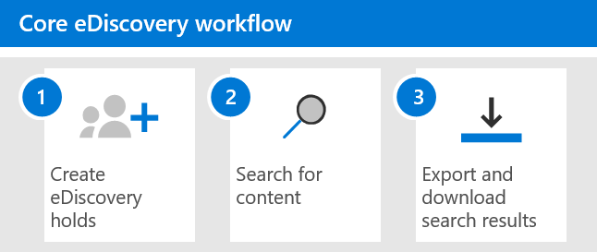
Search and prepare data for Core eDiscovery
To get you started using eDiscovery (Standard), here's a simple workflow of creating eDiscovery holds for people of interest, searching for content that relevant to your investigation, and then exporting that data for further review. In each of these steps, we'll also highlight some extended eDiscovery (Standard) functionality that you can explore.

Slide 27
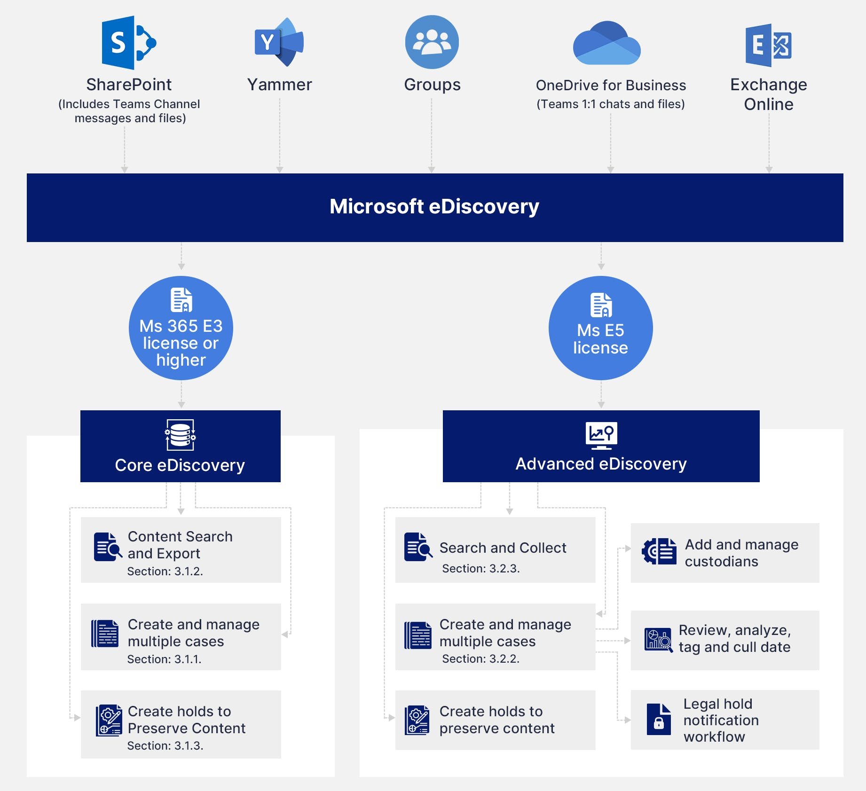

Slide 28
Lab - Core eDiscovery

Slide 29
Lab exercises
Exercise 1: How to create a Core eDiscovery Case?
Exercise 2: How to run an eDiscovery search in a Core eDiscovery case?
Exercise 3: How to create a hold in a Core eDiscovery case?

Slide 30
Module 4: Advanced eDiscovery
In this module students explore how Advanced eDiscovery provides enhanced functionality like OCR, redactions, annotations, legal hold notifications, relevance modeling and adding non-Office 365 documents to the case.

Slide 31
Lesson introduction
After this lesson, you should be able to:
Describe Advanced eDiscovery
Configure permissions for users in Advanced eDiscovery
Create Cases in Advanced eDiscovery
Search and prepare data for Advanced eDiscovery

Slide 32





Advanced eDiscovery explained
Pain points of
“collect and export”
Advanced eDiscovery
design principles
Export
Move sensitive data to other systems
Collect and discover data where it is
Work with disjointed tools
Manage end-to-end workflows in one solution
Lose insights in large amount of data
Find relevant data and insights intelligently
Notes:
Supporting videos for instructor or student use:
Advanced eDiscovery with customer lockbox overview
https://youtu.be/ss41uDIwuO0

Slide 33
Advanced eDiscovery workflow
1
Add custodians to a case
2
Search custodial data sources for relevant data
3
Add data to a review set
4
Review and analyze data in a review set
5
Export and download case data

Slide 34
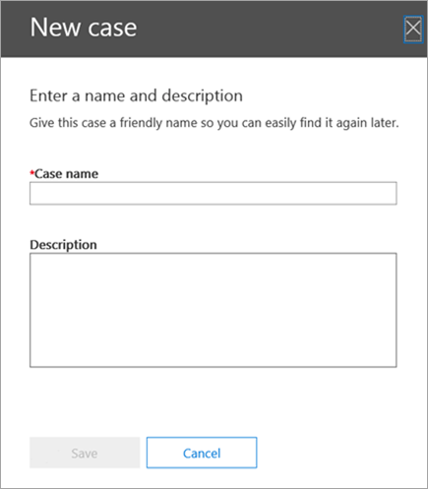
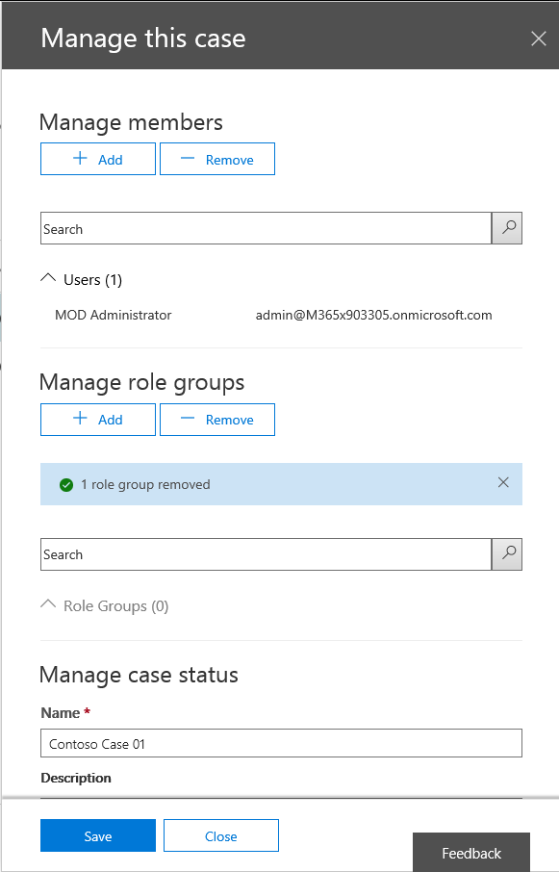
Configure and use Advanced eDiscovery
When working with Advanced eDiscovery, you need to create a eDiscovery case and assign users to it, using the following steps:
Step 1: Assign eDiscovery permissions to potential case members
Step 2: Create a new case
Step 3: Add members to a case
Step 4: Open your case in Advanced eDiscovery
Notes:
Supporting videos for instructor or student use:
Demonstration: Advanced eDiscovery in Microsoft 365
https://youtu.be/-25S-Vz7u1Q

Slide 35
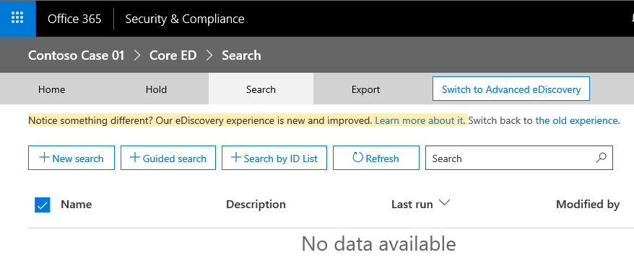
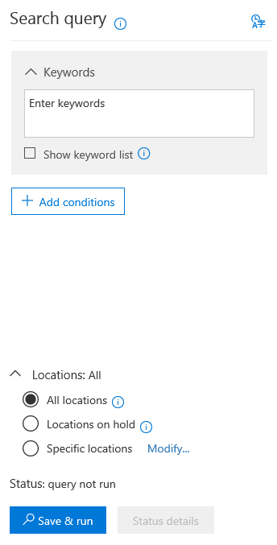
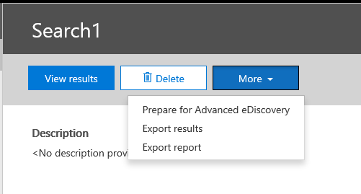
Explore the Advanced eDiscovery workflow
After an eDiscovery case is created, follow these steps to create and run one or more Content Searches that are associated with the case to have data available to analyze in Advanced eDiscovery:
Step 1: Create and run a Content Search associated with a case
Step 2: Prepare search results for Advanced eDiscovery
Step 3: Add the search results data to the case in Advanced eDiscovery

Slide 36
Analyze data in Advanced eDiscovery
Analyzing data applies the following functionality to the included files:
Identifies and organizes the loaded files into groups of unique files, duplicates, and near-duplicates
Identifies and organizes emails into hierarchically structured groups of email threads, based on the progressive inclusiveness of the emails
Enables the use of Themes in Advanced eDiscovery processing and file batching

Slide 37
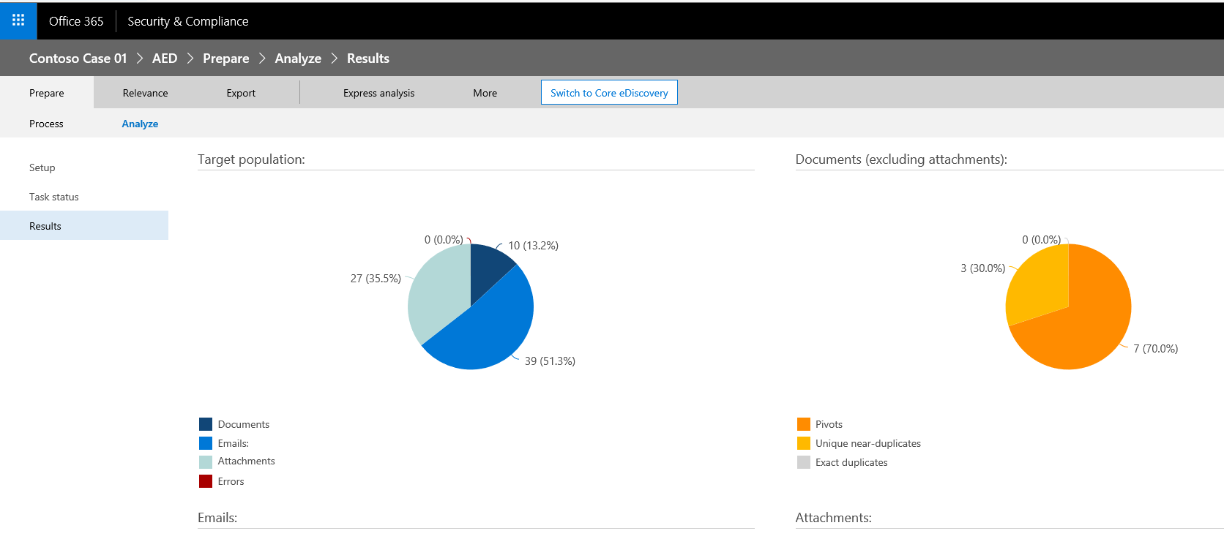
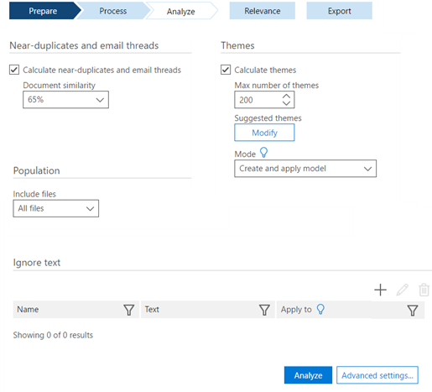
Analyze data in Advanced eDiscovery (continued)
Enables you to set parameters, run options, and view the results, as follows:
Analyze setup. Allows settings to be specified before running Analyze on the files
Analyze results. Displays metrics of the analysis

Slide 38
Lab - Manage Search and Investigation

Slide 39
Lab exercises
Exercise 1: Investigate your Microsoft 365 Data
Exercise 2: Conduct a Data Subject Request

